Slide 1
In Drive Coupon Recommendation
Presented By – Meghraj Konduskar

Slide 2
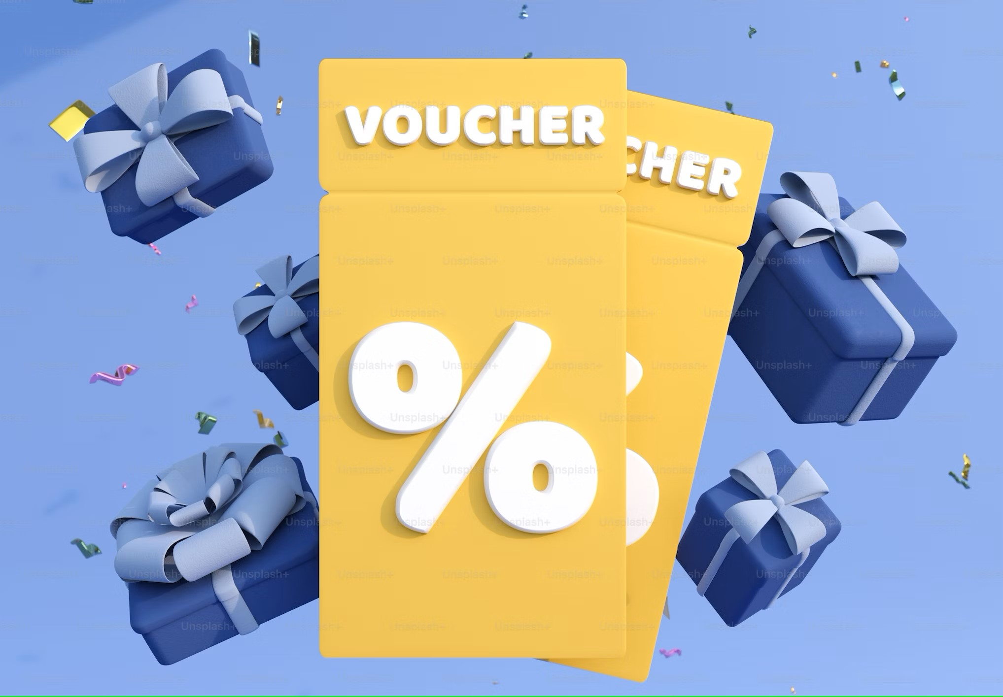
Problem Statement
This data was collected via a survey on the Ecom website Mechanical Turk. The survey describes different driving scenarios including the user’s destination, current time, weather, passenger, coupon attributes, user attributes, and contextual attributes, and then asks the user whether he/she will accept the coupon or not. In this project we have to predict if the user will accept the coupon.
This is a supervised machine learning classification problem.

Slide 3
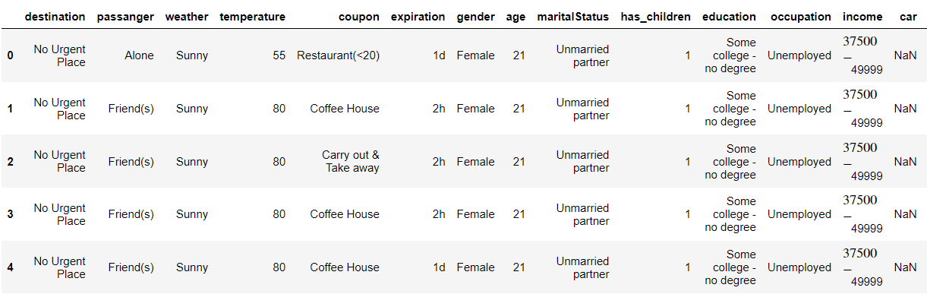

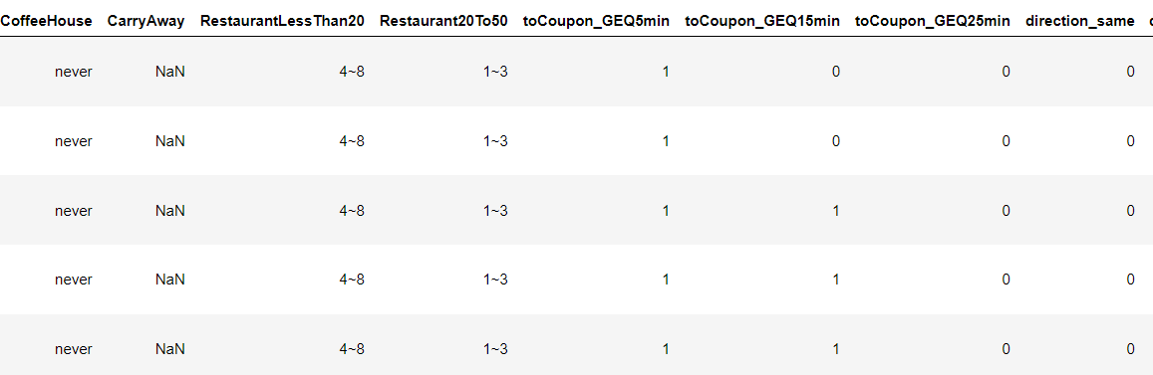
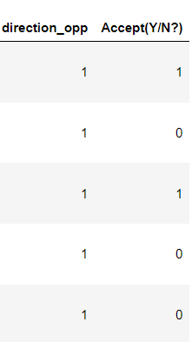
Overview of Dataset.
We have 25 variables and 12684 observations in our dataset.

Slide 4
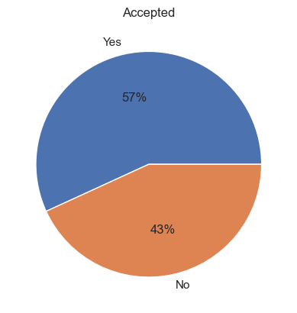
Target Variable (Accepted)
“accepted” is our target variable which contains 1 or 0 for Yes or No. Whether the user has accepted the coupon or not.
We have 7210 observations as “Yes” and 5474 observations as No
Since data is fairly balance I chose accuracy as Evaluation Metric

Slide 5
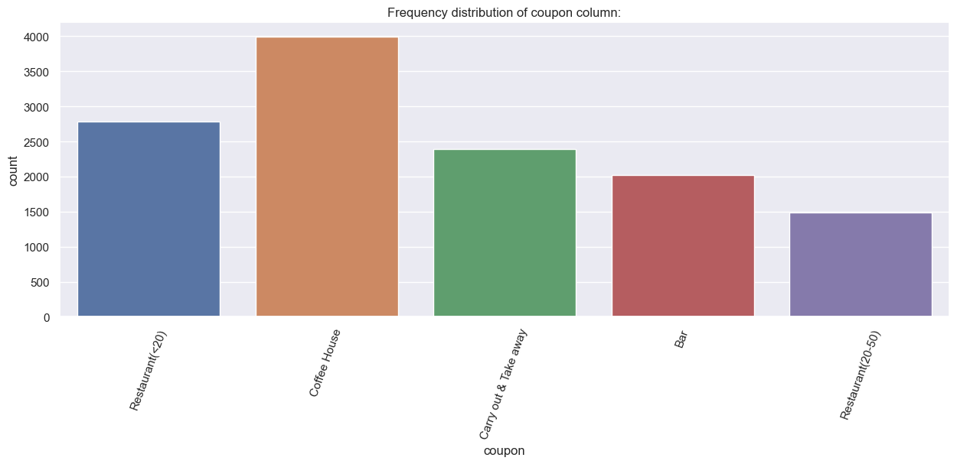
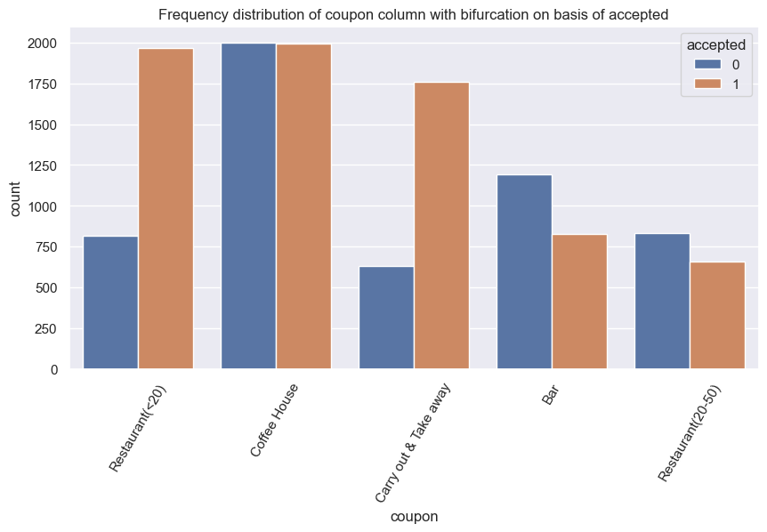
Which type of coupons are available?
Carryout and Takeaway coupons and when the restaurant coupon is less than $20. Customer is more likely to accept these coupons.
We can see when the coupon is for Bar and Restaurant between $20 - $50. These coupons are getting rejected more often
Whereas Coffee house coupons are 50-50 split

Slide 6
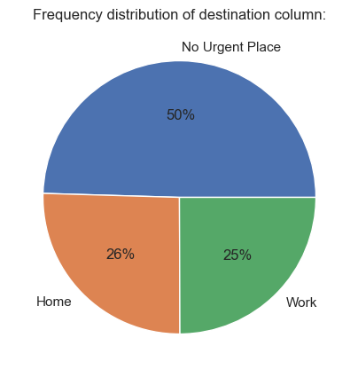
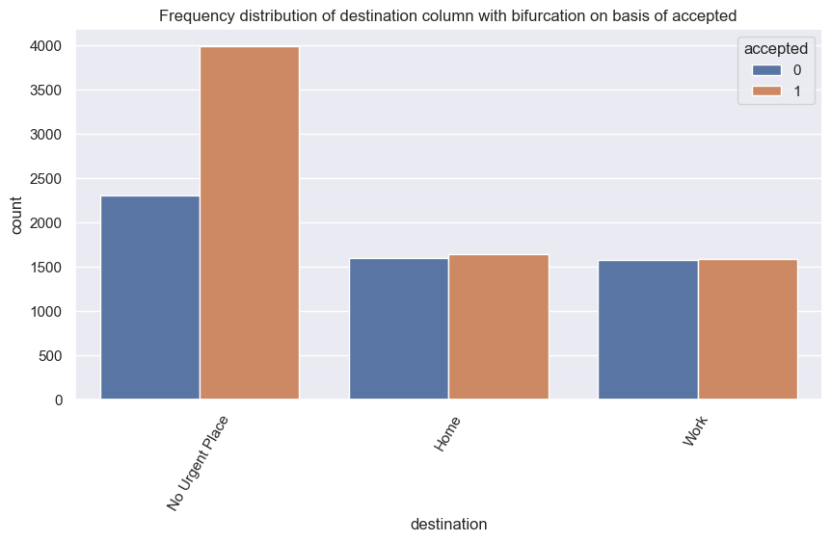
Destination
When customer is not in a hurry to go to any urgent place. He is more likely to accept the coupon

Slide 7
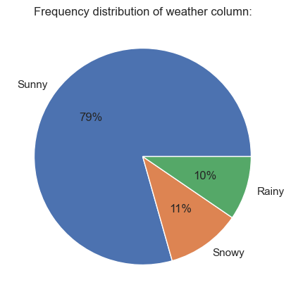
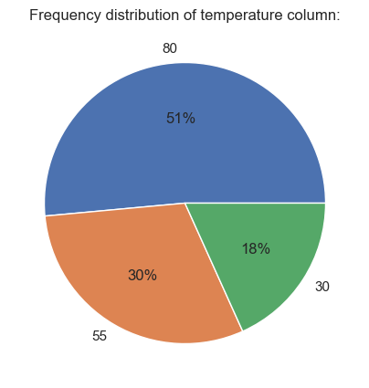
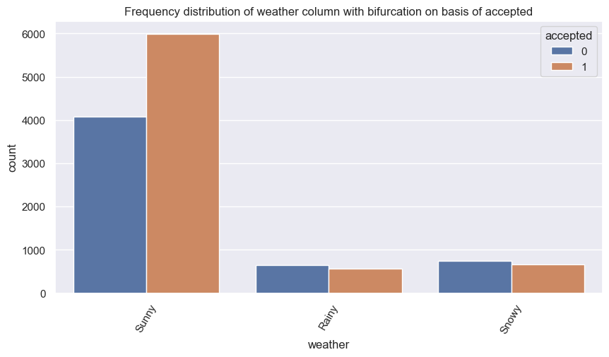
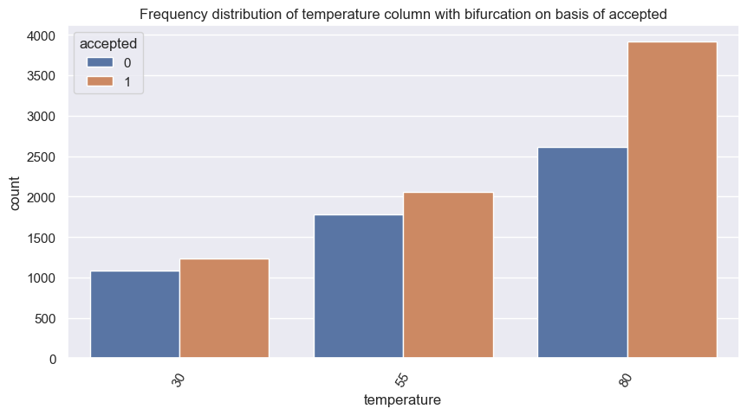
Weather and Temperature
When the weather is sunny and temperature is high, customer is more likely to accept the coupon. And we can see when the weather is rainy or snowy the customer is more likely to reject the coupons

Slide 8
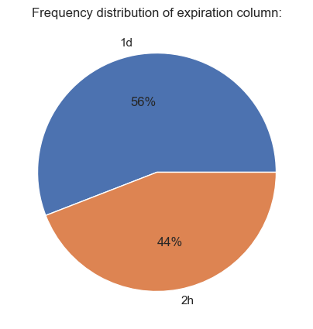
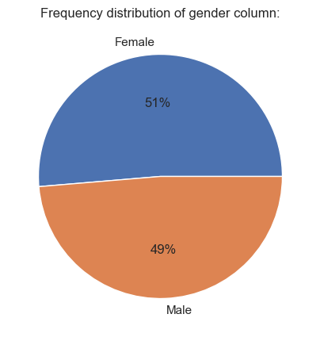
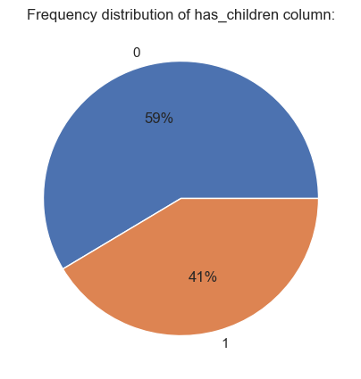
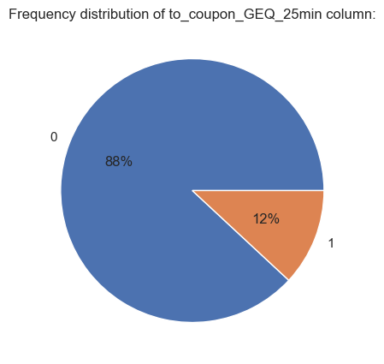
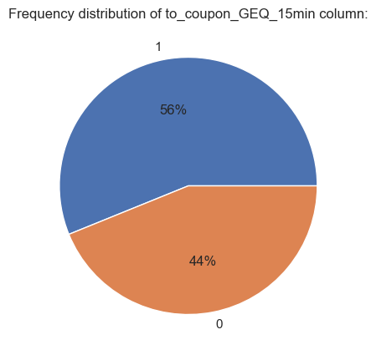
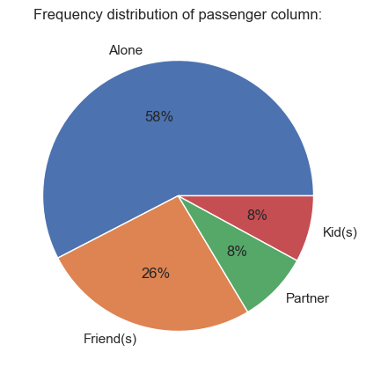
Distribution of other columns

